Slide 1

Decidable and Semidecidable Languages
Chapter 20

Slide 2
D and SD Languages
SD
D
Context-Free
Languages
Regular
Languages

Slide 3
Every CF Language is in D
  Theorem: The set of context-free languages is a proper subset of D.
  Proof:
  ● Every context-free language is decidable, so the context-free languages are a subset of D.
  ● There is at least one language, A^{n}B^{n}C^{n}, that is decidable
  but not context-free.
  So the context-free languages are a proper subset of D.

Slide 4
Decidable and Semidecidable Languages
Almost every obvious language that is in SD is also in D:
A^{n}B^{n}C^{n} = {a^{n}b^{n}c^{n}, n ≥ 0}
{wcw, w ∈ {a, b}*}
{ww, w ∈ {a, b}*}
{w = x∗y=z: x,y,z ∈ {0, 1}* and, when x, y, and z are viewed as binary numbers, xy = z}
But there are languages that are in SD but not in D:
H = {<M, w> : M halts on input w}

Slide 5
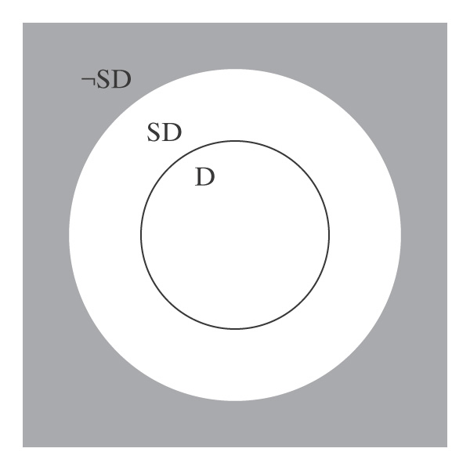
D and SD
D is a subset of SD. In other words, every decidable language is also semidecidable.
There exists at least one language that is in SD/D, the donut in the picture.
There exist languages that are not in SD. In other words, the gray area of the figure is not empty.

Slide 6
Subset Relationships between D and SD
 1. There exists at least one SD language that is not D.
2. Every language that is in D is also in SD: If L is in D, then there is a Turing machine M that decides it (by definition).
But M also semidecides it.

Slide 7
Languages That Are Not in SD
Theorem: 3. There are languages that are not in SD.
Proof: Assume any nonempty alphabet Σ.
There is a countably infinite number of SD languages over Σ.
There is an uncountably infinite number of languages over Σ.
So there are more languages than there are languages in SD. Thus there must exist at least one language that is in ¬SD.

Slide 8
Closure of D Under Complement
Theorem: The set D is closed under complement.
Proof: (by construction) If L is in D, then there is a deterministic Turing machine M that decides it.
M:
y n
From M, we construct M′ to decide ¬L:

Slide 9
Closure of D Under Complement
Proof: (by construction)
M: M':
This works because, by definition, M is:
● deterministic
● complete
Since M' decides ¬L, ¬L is in D.
y
n
n
y

Slide 10
SD is Not Closed Under Complement
Can we use the same technique?
M: M':
y

Slide 11
SD is Not Closed Under Complement
Suppose we had:
M_{L}: M_{¬L}:
Then we could decide L. How?
So every language in SD would also be in D.
But we know that there is at least one language (H) that is in SD but not in D. Contradiction.

Slide 12
D and SD Languages
Theorem: A language is in D iff both the language and its complement are in SD.
Proof:
● L in D implies L and ¬L are in SD:
● L is in SD because D ⊂ SD.
● D is closed under complement
● So ¬L is also in D and thus in SD.
● L and ¬L are in SD implies L is in D:
● M₁ semidecides L.
● M₂ semidecides ¬L.
● To decide L:
● Run M₁ and M₂ in parallel on w.
● Exactly one of them will eventually accept.

Slide 13
A Language that is Not in SD
Theorem: The language ¬H =
{<M, w> : TM M does not halt on input string w}
is not in SD.
Proof:
● H is in SD.
● If ¬H were also in SD then H would be in D.
● But H is not in D.
● So ¬H is not in SD.

Slide 14
Enumeration
Enumerate means list. We look at Turing Machines as generators.
We say that Turing machine M enumerates the language L iff, for some fixed, non-halting, state p of M:
L = {w : (s, ε) |-_{M}* (p, w)}.
Whenever the machine enters p, the string on the tape is enumerated.
If L is finite, then M eventually halts.
A language is Turing-enumerable iff there is a Turing machine that enumerates it.

Slide 15
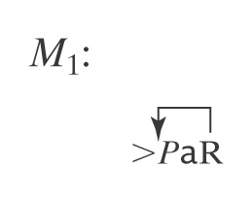
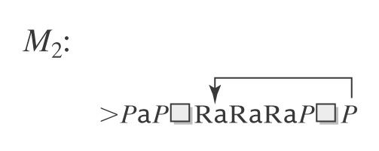
Example of Enumeration
Consider a printing subroutine: P be a Turing machine that enters state p and then halts:
Let L = a*. M₁ and M₂ both enumerate L:

Slide 16
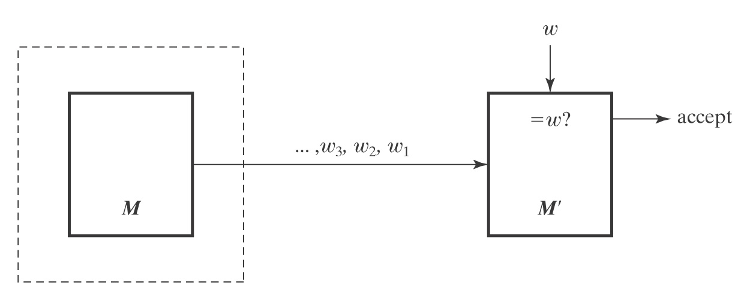
SD and Turing Enumerable
Theorem: A language is in SD iff it is Turing-enumerable.
Proof that Turing-enumerable implies SD: Let M be the Turing machine that enumerates L. We convert M to a machine M' that semidecides L:
1. Save input w.
2. Begin enumerating L. Each time an element of L is
enumerated, compare it to w. If they match, accept.

Slide 17
The Other Way
Proof that SD implies Turing-enumerable:
If L ⊆ Σ* is in SD, then there is a Turing machine M that semidecides L.
A procedure E to enumerate all elements of L:
  1. Enumerate all w ∈ Σ* lexicographically.
  e.g., ε, a, b, aa, ab, ba, bb, …
  2. As each is enumerated, use M to check it.
w₃, w₂, w₁ ∈L? yes w
E
M
M'
Does this work?

Slide 18
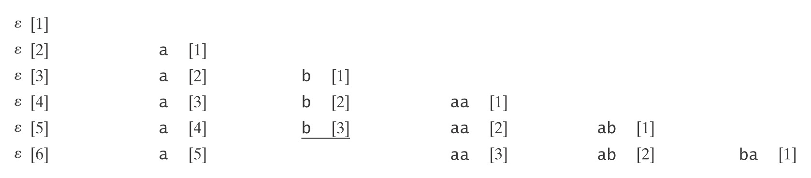
Dovetailing

Slide 19
The Other Way
Proof that SD implies Turing-enumerable:
If L ⊆ Σ* is in SD, then there is a Turing machine M that semidecides L.
A procedure to enumerate all elements of L:
1. Enumerate all w ∈ Σ* lexicographically.
2. As each string w_{i} is enumerated:
  1. Start up a copy of M with w_{i} as its input.
  2. Execute one step of each M_{i} initiated so far, excluding only those that have previously halted.
  3. Whenever an M_{i} accepts, output w_{i}.

Slide 20
Lexicographic Enumeration
M lexicographically enumerates L iff M enumerates the elements of L in lexicographic order.
A language L is lexicographically Turing-enumerable iff there is a Turing machine that lexicographically enumerates it.
Example: A^{n}B^{n}C^{n} = {a^{n}b^{n}c^{n} : n ≥ 0}
Lexicographic enumeration:

Slide 21
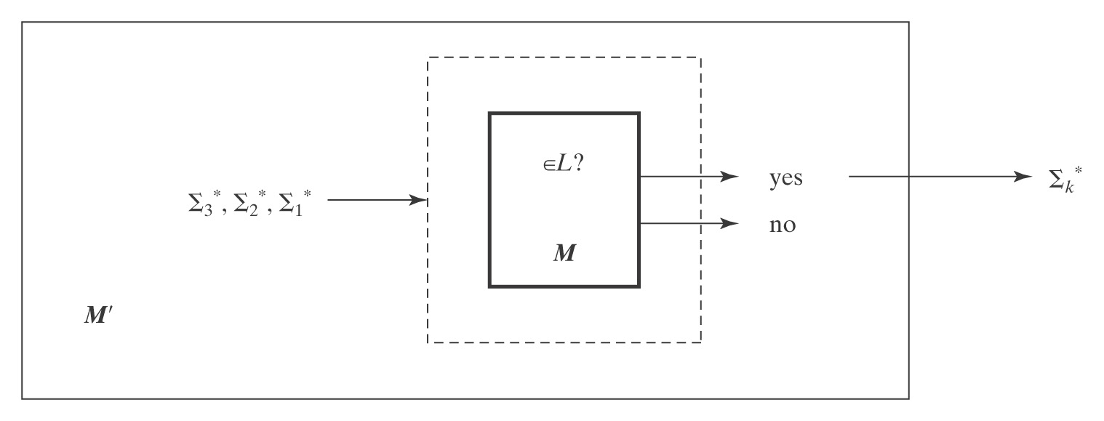
Lexicographically Enumerable = D
Theorem: A language is in D iff it is lexicographically Turing-enumerable.
Proof that D implies lexicographically TE: Let M be a Turing machine that decides L. Then M' lexicographically generates the strings in Σ* and tests each using M. It outputs those that are accepted by M. Thus M' lexicographically enumerates L.

Slide 22
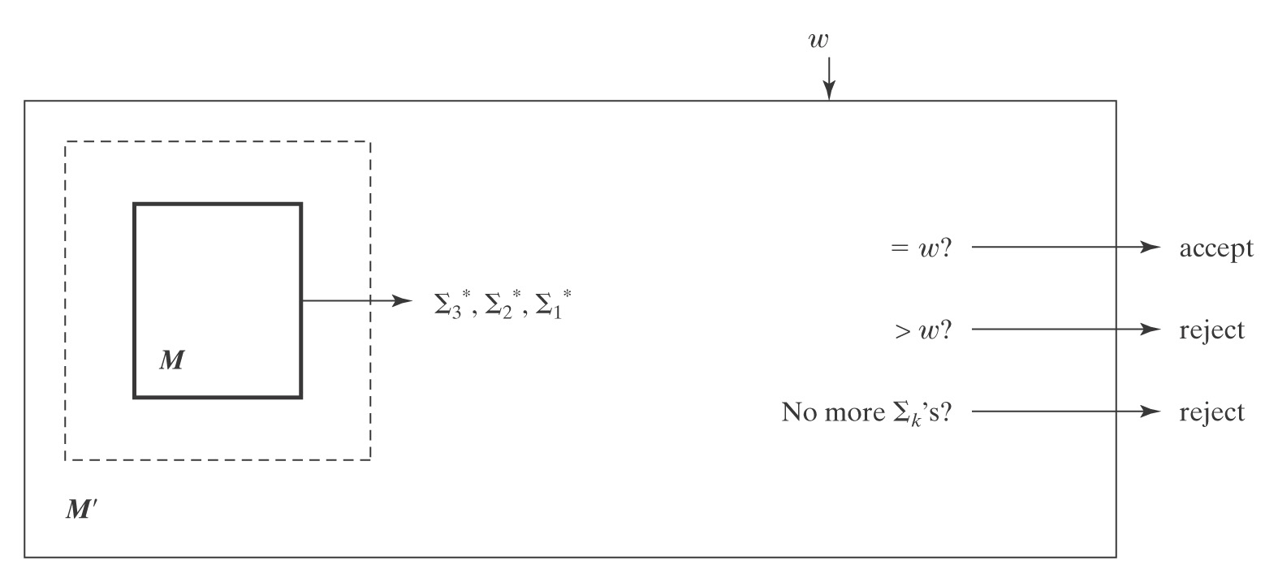
Proof, Continued
Proof that lexicographically TE implies D: Let M be a Turing machine that lexicographically enumerates L. Then, on input w, M' starts up M and waits until:
● M generates w (so M' accepts),
● M generates a string that comes after w (so M' rejects), or
● M halts (so M' rejects).
Thus M' decides L.

Slide 23
Language Summary
IN SD OUT
Semideciding TM H Reduction
Enumerable
Unrestricted grammar
D
Deciding TM A^{n}B^{n}C^{n} Diagonalize
Lexic. enum Reduction
L and ¬L in SD
Context-Free
CF grammar A^{n}B^{n} Pumping
PDA Closure
Closure
Regular
Regular Expression a*b* Pumping
FSM Closure

